Slide 1
ΣΠΣ The Physics and Astronomy Honor Society: Induction Ceremony and Reception
2026-xx-xx
[Department Name], [University Name]
Chapter Chartered on Month xx, year
Notes:
Welcome to the induction ceremony for the newest members of the ___________________ Sigma Pi Sigma chapter.
The Sigma Pi Sigma Chapter of __________________________ was chartered on _______________, and today’s inductees are about to join our community of over 100,000 historic and current members.

Slide 2


SPS & ΣΠΣ – Linked, but Distinct
The Society of Physics Students (SPS) is open to all who have an interest in physics and astronomy. SPS Chapters are chartered at two-year and four-year colleges and universities. With over 800 chapters, SPS is the professional society of undergrad students and their mentors.
Sigma Pi Sigma (ΣΠΣ) is the physics and astronomy honor society and is linked to SPS through our shared constitution. ΣΠΣ chapters are restricted to colleges and universities that offer a strong physics or astronomy program. With over 100,000 lifelong members, ΣΠΣ fosters opportunities to connect and contribute to each other and the broader physics and astronomy communities.
Together they form an organization devoted inclusion and excellence.
Notes:
Sigma Pi Sigma and the Society of Physics Students are a two linked yet distinct set of societies – they share a constitution and bylaws but remain different organizations. The Society of Physics Students has over 850 chapters and welcomes everyone with an interest in physics and astronomy. Part of the mission of SPS is to help build an inclusive environment within departments. All undergraduate student groups within a department which holds an SPS charter are part of SPS.
Sigma Pi Sigma is the corresponding physics and astronomy honors society, which invites students to join for high academic achievement or service to the field and community. With over 100,000 lifetime members, Sigma Pi Sigma strives to connect members to each other, their department, and the broader physics and astronomy community.
Together they form an organization devoted inclusion and excellence.

Slide 3
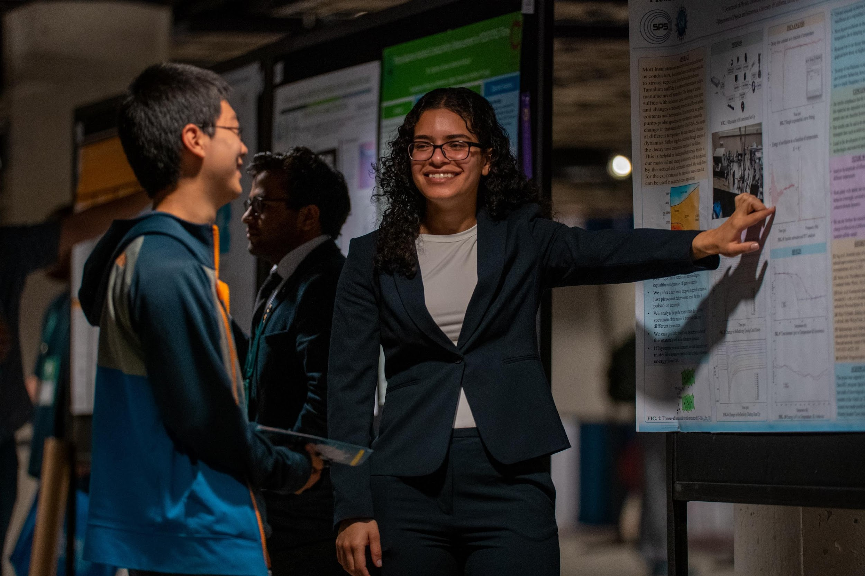
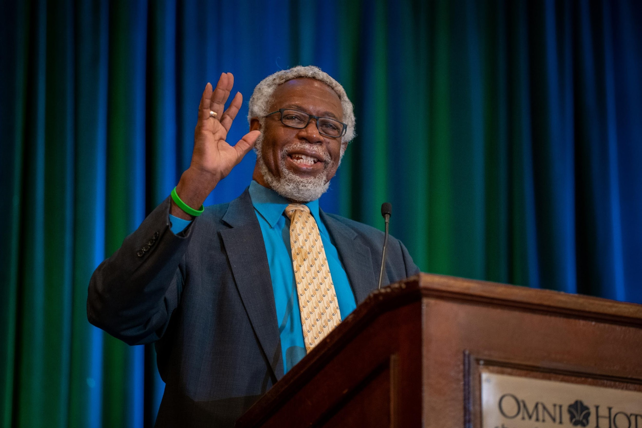
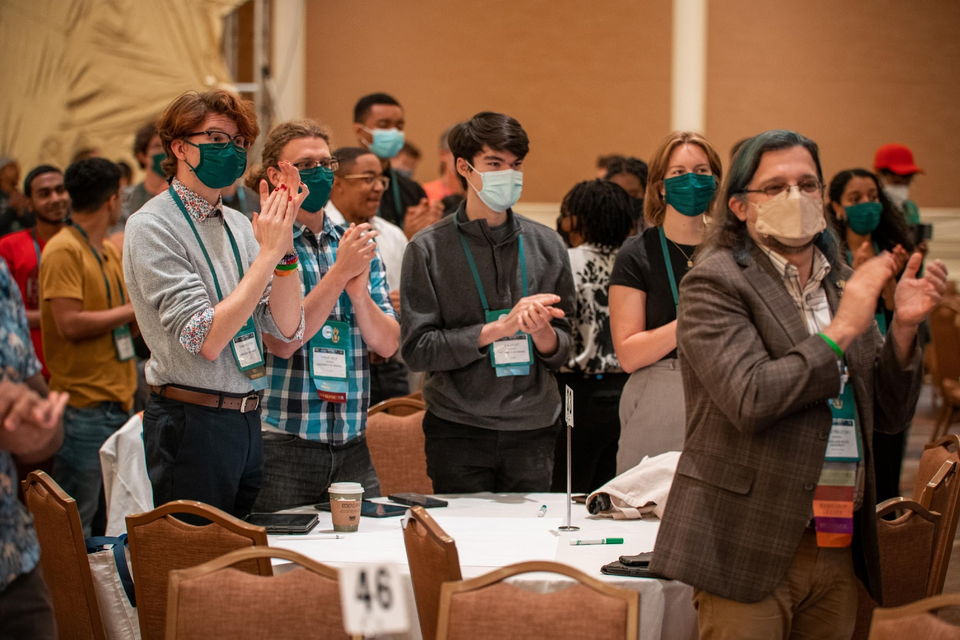
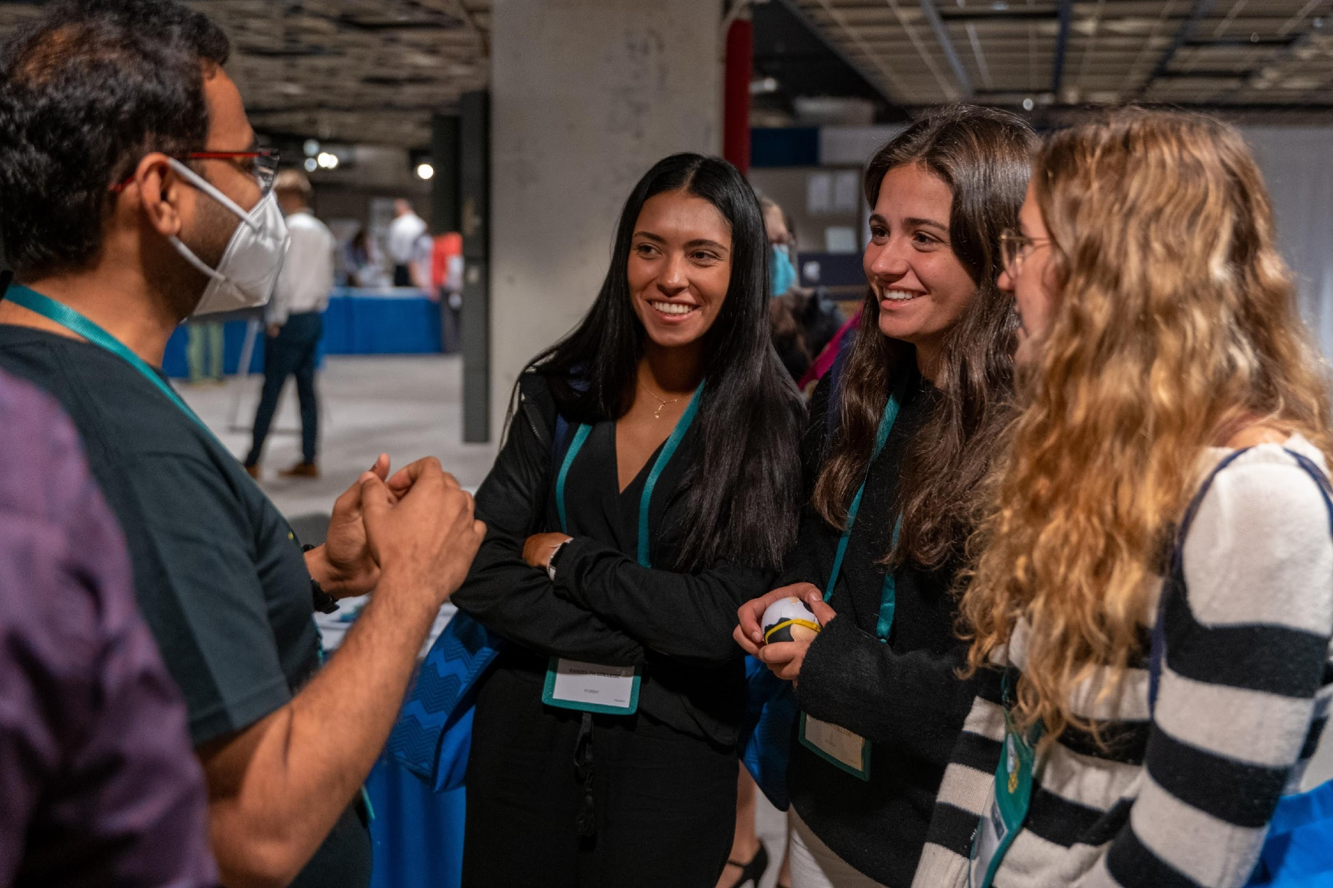
The Mission
Sigma Pi Sigma (ΣΠΣ) exists to:
Honor scholarship
Encourage interest in
physics and astronomy
Promote service
Provide fellowship
Notes:
Sigma Pi Sigma strives to uphold its mission: to recognize outstanding scholarship in physics and astronomy, to encourage interest in physics and astronomy among students at all levels; to promote an attitude of service of its members towards their fellow students, colleagues, and the public; and to provide a fellowship of persons who have excelled in physics and astronomy.

Slide 4
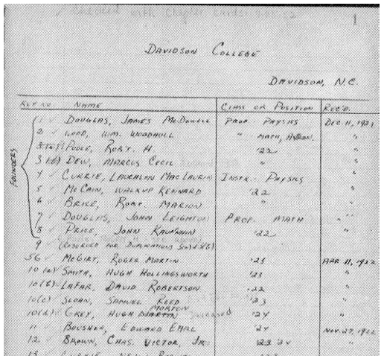
A brief History of ΣΠΣ
ΣΠΣ was established at Davidson College, NC on December 11, 1921
“I became acquainted with some students at Davidson College, NC… a very high-class liberal arts college… [They] came up with ΣΠΣ… I said, ‘Oh… that’s what we ought to have here at Penn State.”
Marsh White, ‘founder’ of Sigma Pi Sigma
The first signatures in the first red book
Notes:
Our chapter was established on ___________________ in ________ but the organization goes back further.
The history of Sigma Pi Sigma begins in 1920. That year several physics students and faculty members at Davidson College in North Carolina decided that a physics and astronomy honor society would be a good idea. In addition to recognizing excellence in physics and astronomy, an honor society could bring those interested in physics and astronomy into closer association and encourage them in their professions. Their idea was realized on December 11, 1921, when five students and four faculty members, meeting in the home of the head of the Davidson College Physics Department, formed a group which they named Sigma Pi Sigma.
From the beginning, Sigma Pi Sigma has been students, alumni, and faculty striving to support undergraduates.

Slide 5
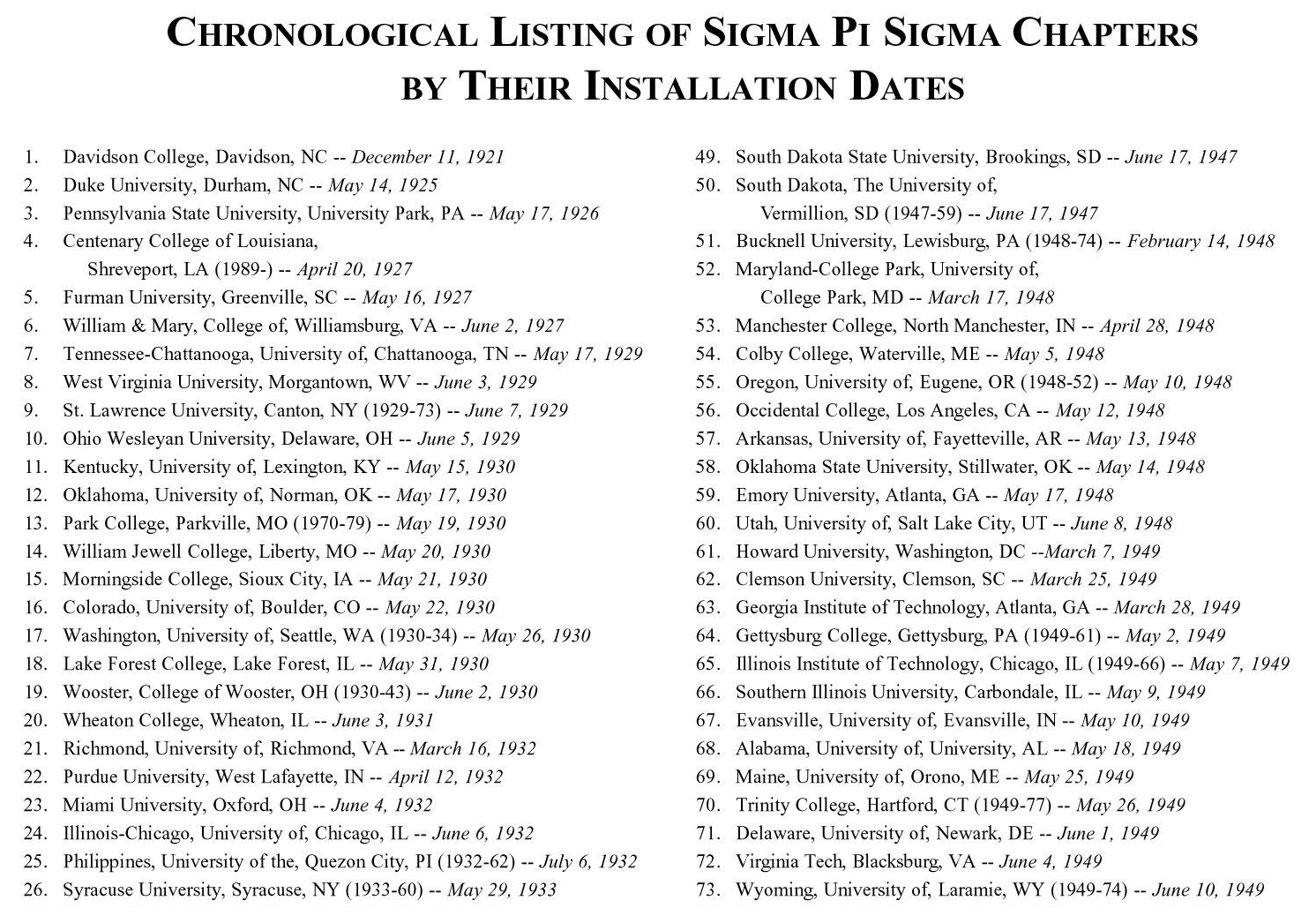

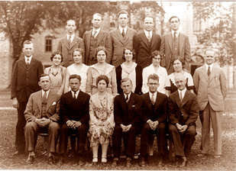
The beginning…
Marsh White at the Wheaton College ΣΠΣ Installation Ceremony (1931)
Notes:
After several years, word spread of the success of the group and the Davidson ΣΠΣ members began to think that the benefits of ΣΠΣ membership could be shared with others. ΣΠΣ began to grow with the installation of a second chapter at Duke University on May 14, 1925; a third chapter was chartered at Pennsylvania State University on May 17, 1926, by Marsh White. The first national convention of ΣΠΣ was held at Davidson College in 1928 with the six existing chapters participating. By 1929 there were ten ΣΠΣ chapters

Slide 6
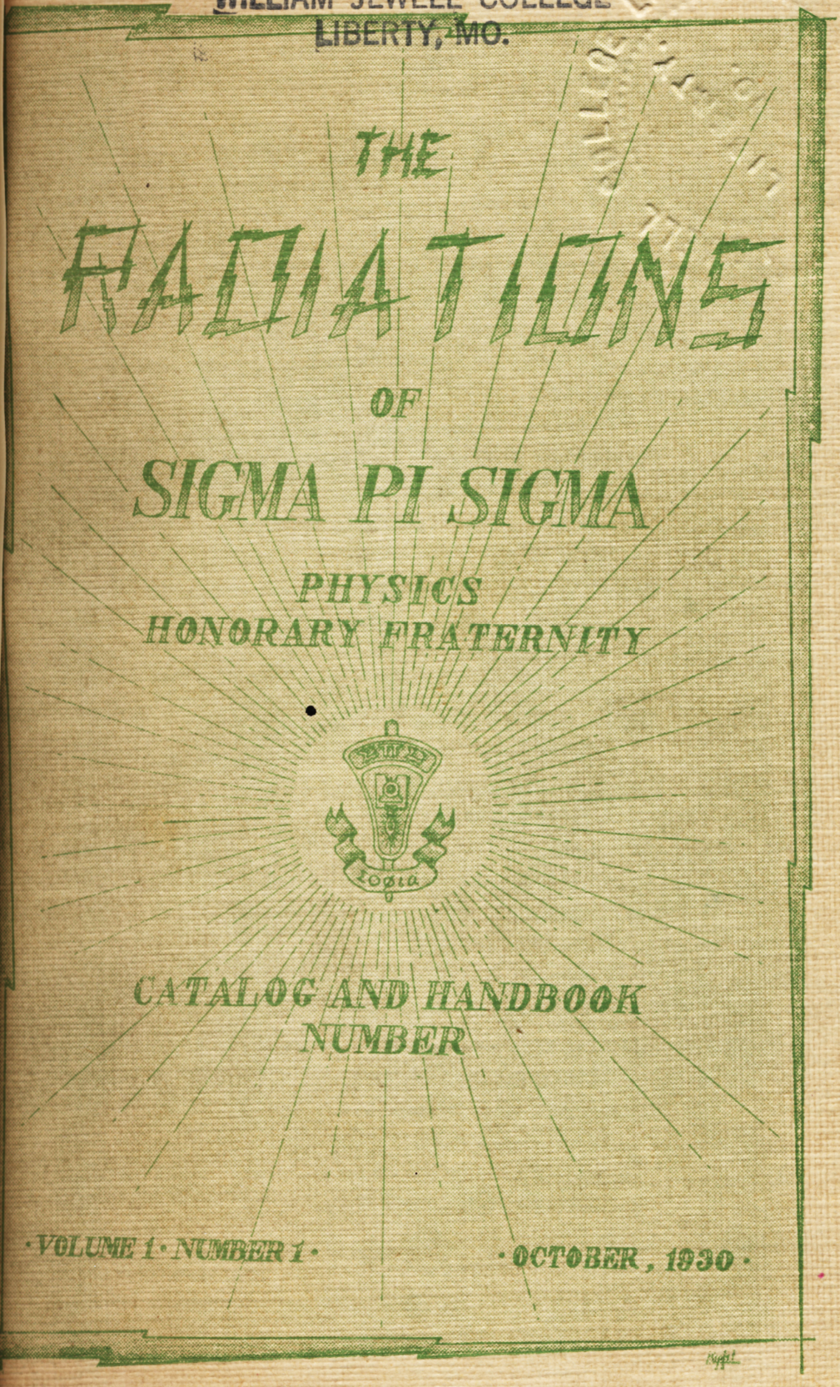
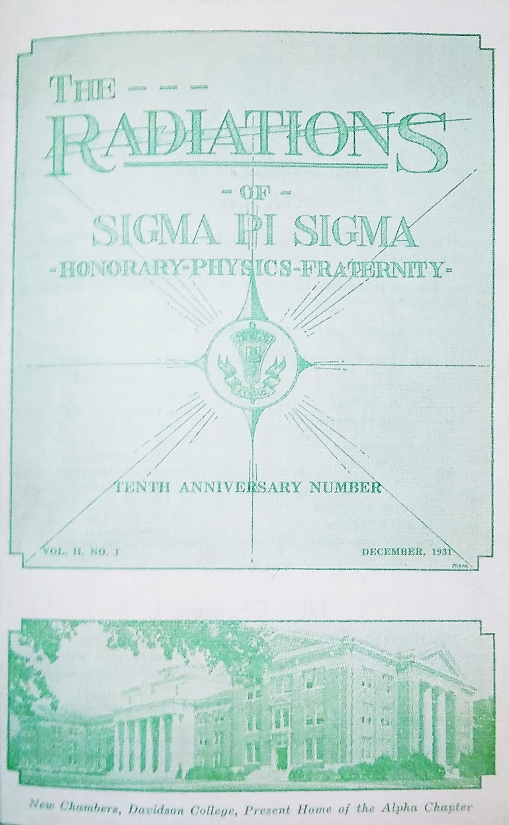
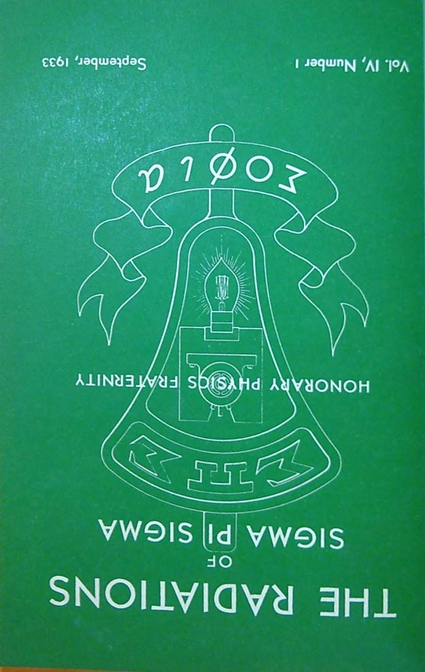
Supporting Physics and Astronomy
“From such a modest beginning, … ΣΠΣ has grown. …The most serious subject for consideration at the first business meeting after organization was a discussion by Price, Brice and Dew [founding members] as to how much voltage could be applied to “Wooly” Grey, [member of the first induction class] without doing him any permanent injury. A moderate voltage was decided upon, and applied at a later date.” – Radiations, December 1931
The next entry states that a several moderate voltage
were applied and that Wooly was mostly unharmed.
First Covers of the Radiations Publication
Since its inception, ΣΠΣ & SPS have supported department goals and been reflections of our community.
Notes:
From it’s founding, Sigma Pi Sigma has strived to represent not just academic excellence but also fellowship and service. Sigma Pi Sigma aims to represent all of the ideals that we strive for as a department. This can be seen in the featured quote from a 1931 summary of the activities of the first 10 years of Sigma Pi Sigma. It was later recorded that “Wooly Grey” conducted the experiment and was mostly unharmed by the chapter’s light-hearted (yet electrifying) fun.

Slide 7
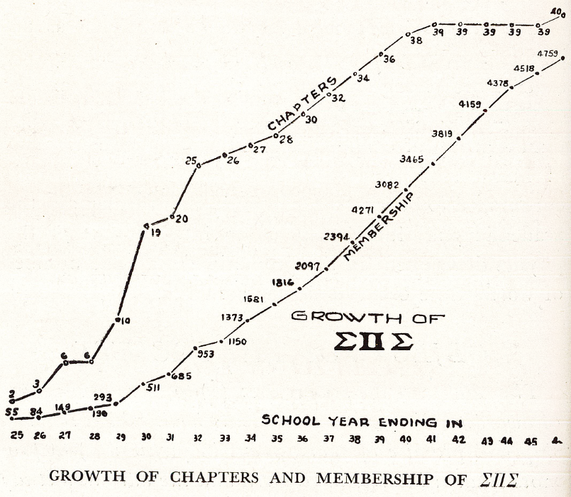
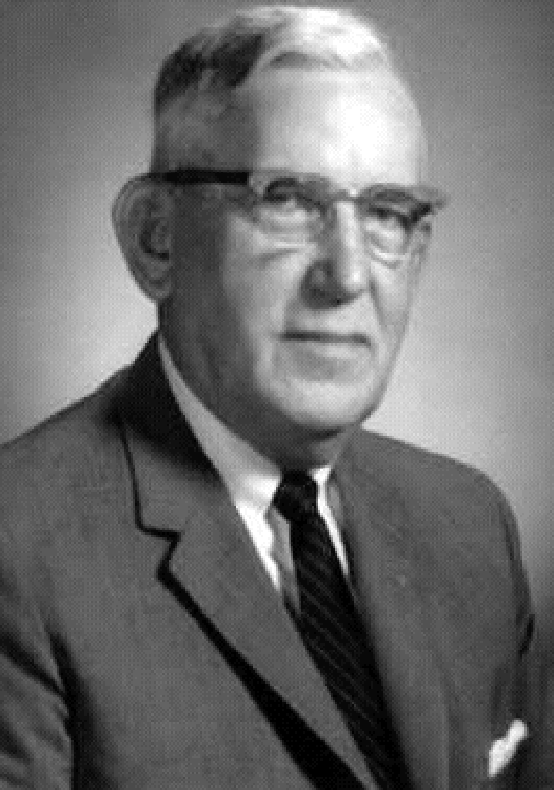
Marsh W. White
Students from chapters would gather every few years to form ‘congresses’ that would guide how the organization supported students and members. Congresses helped to promote the new organization.
1st Congress 1928: Davidson College, NC
4th Congress 1939: Ohio State University, OH
7th Congress 1962: University of Kansas, KS
11th Congress 2000: College Park, MD
13th 2008: Fermilab, IL
16th 2022: Washington, DC
“…You’re supposed to remember them [secret handshakes and such], but I’ve forgotten. When I’d go to install a chapter I’d teach it all to them. You used to shake hands and … say certain names or phrases.” – Oral Interview with M. White
Notes:
At the third national convention at Purdue University in 1934 with all 19 chapters attending, the original name was changed to “society” and all elements of secrecy were removed to align itself with the other physics organizations. In 1936, ΣΠΣ became and remains to this day an Associated Society in the Physics Section of the American Association for the Advancement of Science (AAAS). In 1945, ΣΠΣ became a member of the Association of College Honor Societies (ACHS), the national accrediting organization. By the end of the 1940’s there were 73 chapters. In the early 1950’s ΣΠΣ became an Affiliate member of AAAS.
Along the way, the organization would bring together chapters every few years to help members to network and provide guidance on how the organization could support students and members . Meetings have taken place all over North America.

Slide 8

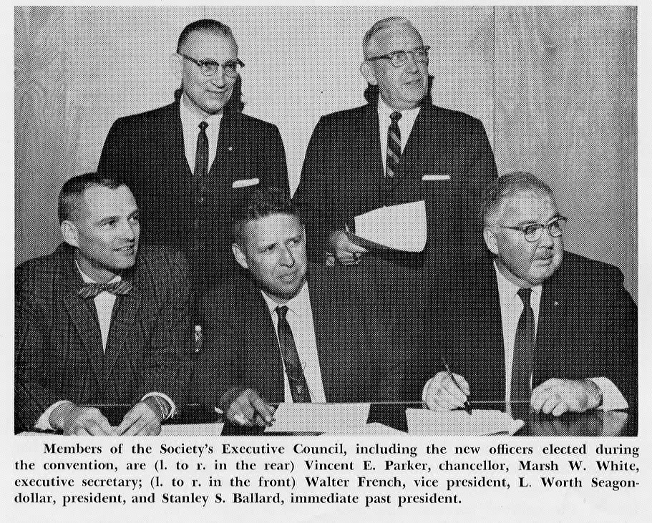
An organization evolving
In the 1950’s, AIP (American Institute of Physics) and SPS began hatching a plan to support students and education issues. On April 22, 1968, Articles of Agreement between the AIP Student Sections and ΣΠΣ were signed, creating a joined Society of Physics Students (SPS) and ΣΠΣ. Both societies remain supported by AIP to this day.
The organization continues to evolve - in 2021, SPS and ΣΠΣ changed its constitution to explicitly define that both societies must support both physics and astronomy students.
Notes:
During the 1950’s, the American Institute of Physics (AIP) and ΣΠΣ began discussing the role of students within the broader Physics Sciences. The AIP Student Sections were established and work began on drafting a Constitution and Bylaws that would result in the union of ΣΠΣ and the AIP Student Sections to create the Society of Physics Students (SPS) as we know it today. At the eighth national convention of ΣΠΣ, held at Purdue University in December 1967, the union between the AIP Student Sections and ΣΠΣ was approved. On April 22, 1968, articles of agreement were signed, creating the Society of Physics Students with ΣΠΣ included as an honor society within SPS.
The organization continues to grow and evolve. For example, on our 100-year anniversary in 2021, SPS and ΣΠΣ explicitly defined both societies to support students studying physics and astronomy.

Slide 9
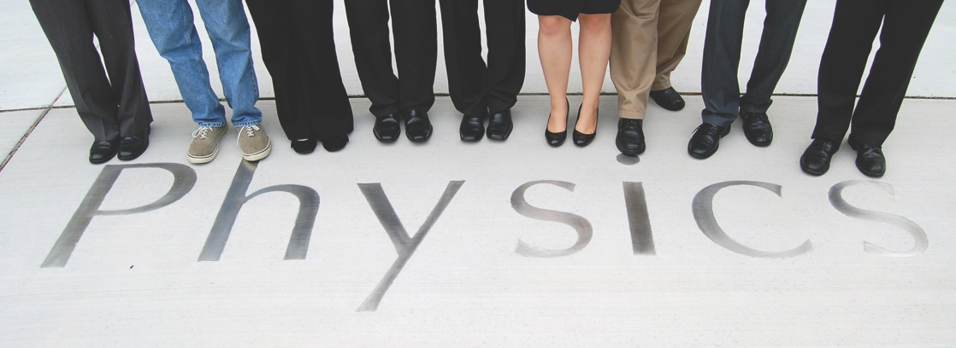
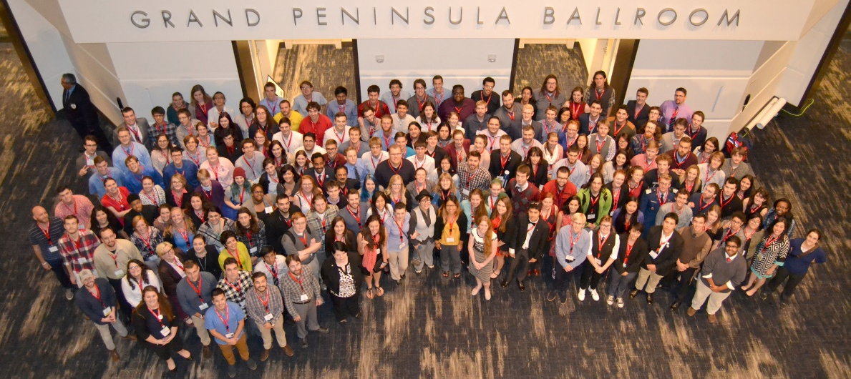
SPS & ΣΠΣ today
Our societies continue to grow:
+ 840 SPS chapters
+ 580 ΣΠΣ chapters
+ 100,000 lifetime ΣΠΣ members
+100 Honorary ΣΠΣ Members
+40 international chapters
New ΣΠΣ Service Awards
New ΣΠΣ Leadership Scholarship
Yearly Regional Events
Physics and Astronomy Congresses
Notes:
Currently SPS has over 840 chapters across the globe and new chapters are being added each year. Sigma Pi Sigma now has over 100,000 lifetime members and spans the generations that have developed modern physics and astronomy.

Slide 10
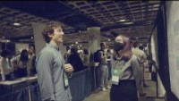
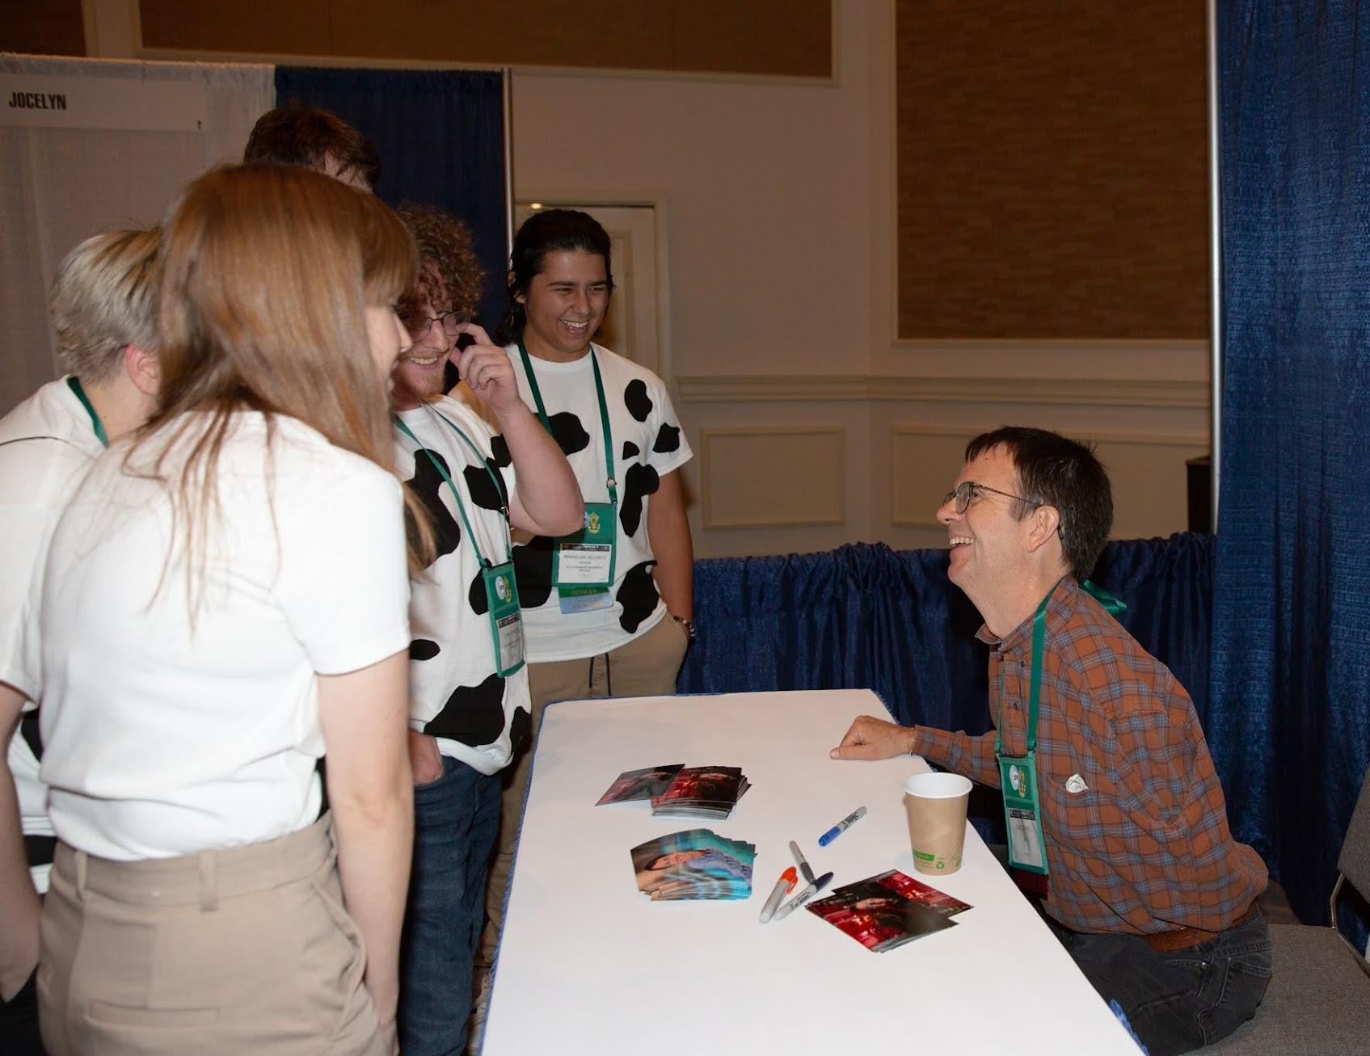
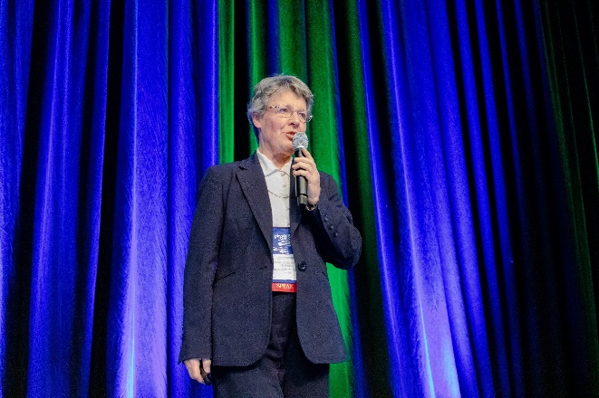
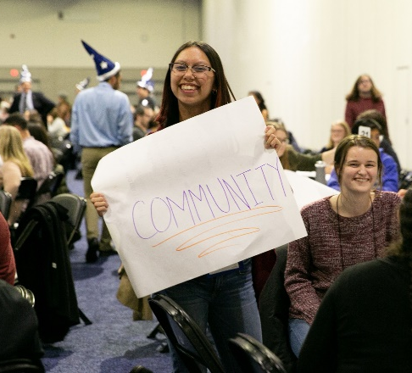
ΣΠΣ Physics and Astronomy Congresses
Click on the picture for a video about the 2025 Congress
ΣΠΣ and its members are the official hosts of the Physics and Astronomy Congresses. This meeting aims to provide students:
National voice around issues facing their departments
Strong connection to the national organization of SPS & ΣΠΣ
Networking and Community Building initiatives
Career and graduate school guidance
Recent themes:
2025 – Σupporting Πhase Σhifts
2022 – 100 years of Momentum
2019 – Making Waves & Breaking Boundaries
2016 – Unifying Fields: Science Driving Innovation
Notes:
Our largest meeting as a society happens every few years through the Congresses. Now called the Sigma Pi Sigma Physics and Astronomy Congress, we come together as a society to reflect, learn, and celebrate our successes.
Sigma Pi Sigma is the official host of the event with the invaluable support of AIP and its 10 member societies. The congress focuses on building community and fellowship within the community, with a strong focus on undergraduates, through interactions with Sigma Pi Sigma members and SPS alumni.
It’s a meeting for and put on by students that also turns out to be a whole lot of fun.
Events such as interactive workshops, plenaries by leaders within the field, and tours of some of the most important scientific locations within the US highlight each congress. Notable speakers at previous Congresses have included members Jocelyn Bell-Burnell and Nobel Laureates such as Eric Cornell, Carl Wieman, John Mather, and William Phillips.

Slide 11
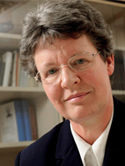
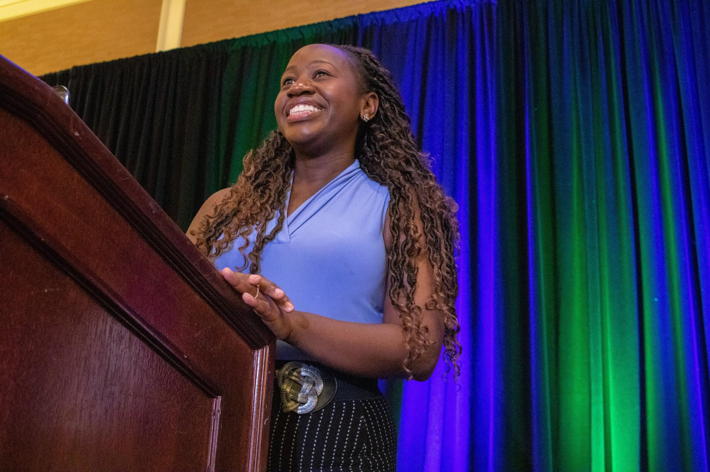
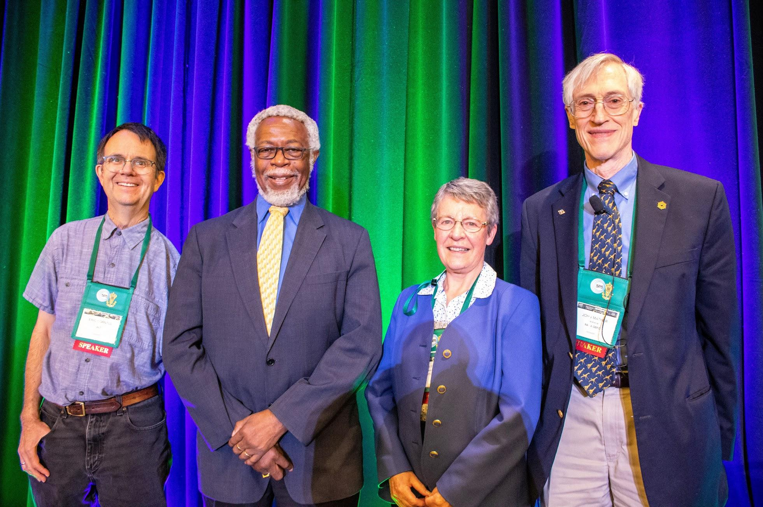
2025 Physics and Astronomy Congress -Σupporting Πhase Σhifts
October 30 – November 1, 2025
Downtown Denver, Colorado, USA
Two poster sessions
ΣΠΣ member day and reception
UC Denver sponsored High Energy Hot Chocolate and Game Night
SPS Chapter/Club Showcase
21 workshops
Tours of regional laboratories
Visits to local PhD Programs
Lunch with Scientists
Honorary Chair:
Dame Jocelyn Bell Burnell
Confirmed Plenaries:
Eric Cornell, NIST/JILA
Renee Horton (Workshop)
Sarah Hurst
Julieann Pollard-Larkin, MD Anderson Cancer Center
Donnell Walton, Corning Inc.
Notes:
The 2025 Physics and Astronomy Congress was rousing success! Set in downtown Denver Colorado, the meeting ran from Thursday through Saturday evening. Students had the opportunity to meet Sigma Pi Sigma members from across the globe, discover potential career pathways, connect to chapters from over 250 universities, and tour some of the leading scientific institutions in the US. Most meeting sessions were interactive, in the tradition of Sigma Pi Sigma and the Physics/Astronomy community. To begin the event, we formed a congress to discuss the state of the community, identify future directions for the organization, and cast votes on ballots placed before the chapters.

Slide 12
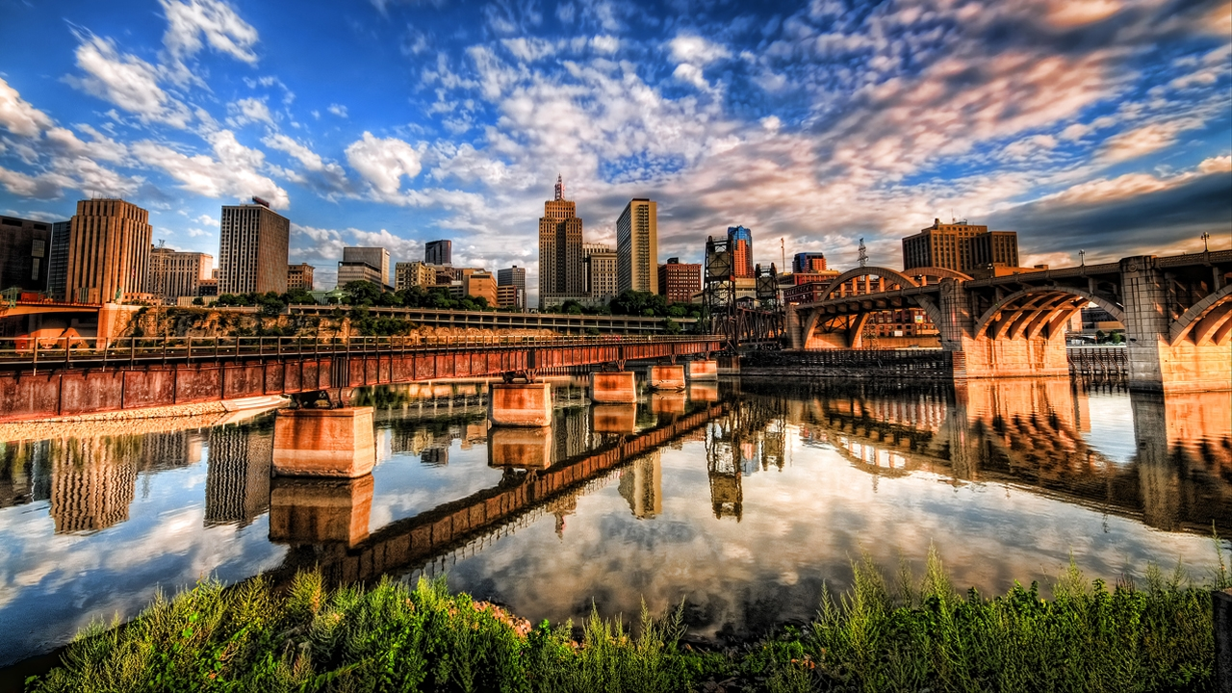
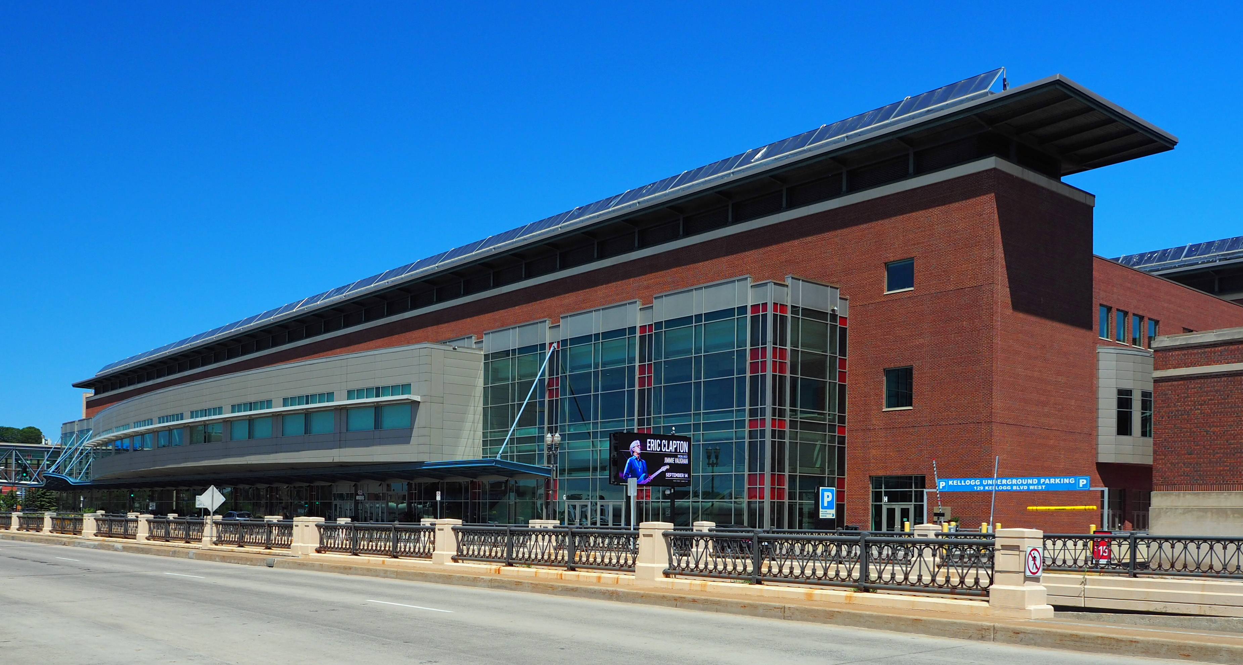
2028 Physics & Astronomy Congress
October 26- 28, 2028
Saint Paul, Minnesota
Saint Paul River Centre
Theme: TBD
Notes:
The next Congress is already being planned for October 26 to 28, 2028. We will meet in Saint Paul, Minnesota. The theme of the Congress is still being developed. Please join us at the Congress or consider supporting students from your chapter to attend.

Slide 13
Lifelong Service Opportunities
Sigma Pi Sigma members serve the physics community in many ways, for example:
Supporting local and national SPS programs
Representing physics to the public
Providing alumni networks
Working for sound national science policies
Offering science outreach opportunities
Notes:
Service
Our membership cuts across generational lines and represents who we are as a community. Our first members were inducted in 1921. Our newest members are being inducted today. This represents many generations of experience and wisdom that can be brought to bear on the matters that unite us. Together, we are the community and we must support each other.
With the recognition of accomplishment comes a responsibility to service at all levels.
Nationally, Sigma Pi Sigma members can serve by helping to work for sound national science policies. Locally, Sigma Pi Sigma members can serve in community science education projects and liaisons and in mentoring individual students. Such personal initiative provides opportunities for all members of the local community to learn more about physics and provides visible testimony to the high standards of Sigma Pi Sigma membership. Our colleges, universities, and our Society know that, when we become alumni, because we respect the personal struggle for excellence, we will support the generations of students that follow us. When the experience of Sigma Pi Sigma members is placed at the service of others at any level, then Sigma Pi Sigma touches more lives than may be counted by the number of its members.

Slide 14
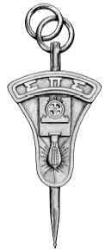
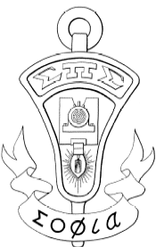

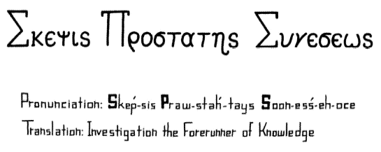
Symbolism
The Key
Voltmeter with lamp & dynamo
The Insignia
The Seal
The Motto
Notes:
Motto: The motto of the Society is Σκεψιζ Προστατηζ Συνεσεως - (pronunciation: Skep-sis Praw-stah-tays Soon-ess-ea-os)
This motto, translated from the Greek, can be translated as “investigation, the forerunner of knowledge” or “the active pursuit of knowledge” which speaks to the goal of physics and astronomy – to understand that which is unknown! Our name, Sigma Pi Sigma, comes from the first letters of this motto. The motto emphasizes that experiments are the basis of progress in science.
Key: The key is the original student design. It has the shape of the historic standard voltmeter. Arched across the top is the name of the society. In the apex of the key is an incandescent lamp connected to a dynamo in the center. The pin, which symbolizes your membership in the society, has this shape. The founders of the Society used the standard voltmeter to symbolize the high accuracy which is the hallmark of careful experiments; the lamp is the symbol of knowledge and the dynamo represents the creative energy that is so necessary to productive research.
Insignia: The official insignia consists of an outline figure of the key with a scroll superimposed on the stem. The Greek word Σοφια (pronounced “so-fya”), or knowledge, is written on the scroll.
Seal: The seal was student designed and this is a scan of the original. It is a circle with the name of the Society around the top. The greek word φυσικα (pronounced “phys-e-ca”), the root word for physics, is in the center. At the bottom is the founding year of ΣΠΣ.

Slide 15
Induction: Signing of the Book
Remember, as you pen your name,
ΣΠΣ was founded by students and faculty.
You are joining a distinguished group, connected by common ties of physics and astronomy.
You are uphold honor, encouragement, and lifetime service and fellowship.
Signing begins a lifelong connection to the society and your chapter.
Notes:
The Induction - [Presiding Officer or designated individuals]
Our new members should always remember that Sigma Pi Sigma was founded by students and continues to exist mainly for their benefit. The standards for ΣΠΣ membership are very high so that only those deeply interested in physics will be eligible for membership. We will now induct the new members. Each new member, when your name is called, please come forward and receive your pin and certificate and sign the membership book. Your signature in the membership book signifies your acceptance of your Sigma Pi Sigma membership and of the responsibility to lifetime service that goes with it.
We suggest asking the advisor or chapter officers to assist in welcoming the new members. Call new members up one by one, and after each person signs the chapter book, everyone should shake their hand and say “Welcome to Sigma Pi Sigma” before presenting them with their pin, membership card, magazines, pen, etc. Lots of swag!
Ask them to stay up front to line up for the continuation of the induction!

Slide 16
The ΣΠΣ Pledge
When called, repeat the following so that all may hear:
I, Your Name, agree to uphold the pillars of ΣΠΣ:
Encourage those seeking knowledge and competence in physics and astronomy;
Develop and maintain an attitude of service;
Support colleagues, promote fellowship, and honor excellence in physics and astronomy;
And, encourage scholarship in physics and astronomy, at all levels.
Notes:
The Induction Pledge - [Presiding Officer or designated individuals]
I will ask you all to recite this together, it is always fun when you each say your own name all at the same time! It is okay to turn so that you can see the screen!
I, Your Name, agree to uphold the pillars of Sigma Pi Sigma:
Encourage those seeking knowledge and competence in physics and astronomy;
Develop and maintain an attitude of service;
Support colleagues, promote fellowship, and honor excellence in physics and astronomy;
And encourage scholarship in physics and astronomy at all levels.

Slide 17
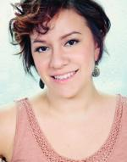
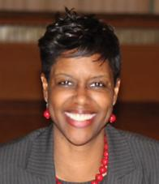
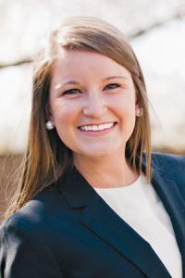

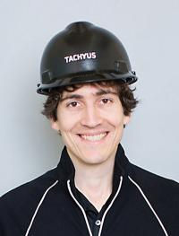
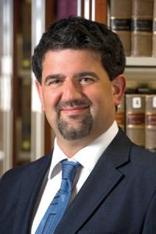
Charge to New Members
Continue your commitment as physicists and astronomers to honorable scholarship, irrespective of your ultimate career trajectory. Traditional scientists and ‘hidden physicists and astronomers’ alike are critical to the future of society.
Notes:
The Charge to New Members
[Presiding Officer or designated individual]
It is now my great privilege to declare you members of Sigma Pi Sigma, and having all the rights, privileges and responsibilities of members of this Society.
I will now give the Charge to our New Members.
Those of us who are gathered here today have a real and enduring interest in physics. We believe in the importance of physics as a basic science and as a contributor to a strong and just society and country. We charge you to continue your commitment to physics, working to assist the development of interest in physics at all possible levels. One finds Sigma Pi Sigma members among all professions. There are practicing physicists among Sigma Pi Sigma members. Excellence in physics has also led members into other careers. Through these members, Sigma Pi Sigma has enriched the world beyond just the professional physics community. Sigma Pi Sigma unites a diverse group of exceptional people who have shared in the culture and traditions of physics.
With the common thread of this shared background in physics, Sigma Pi Sigma promotes a spirit of professional community among its members and encourages them to offer their collective wisdom and perspective in the service of the larger society. You are joining a group in which you may play an active part for the rest of your life. We are happy to welcome you into this fellowship.

Slide 18
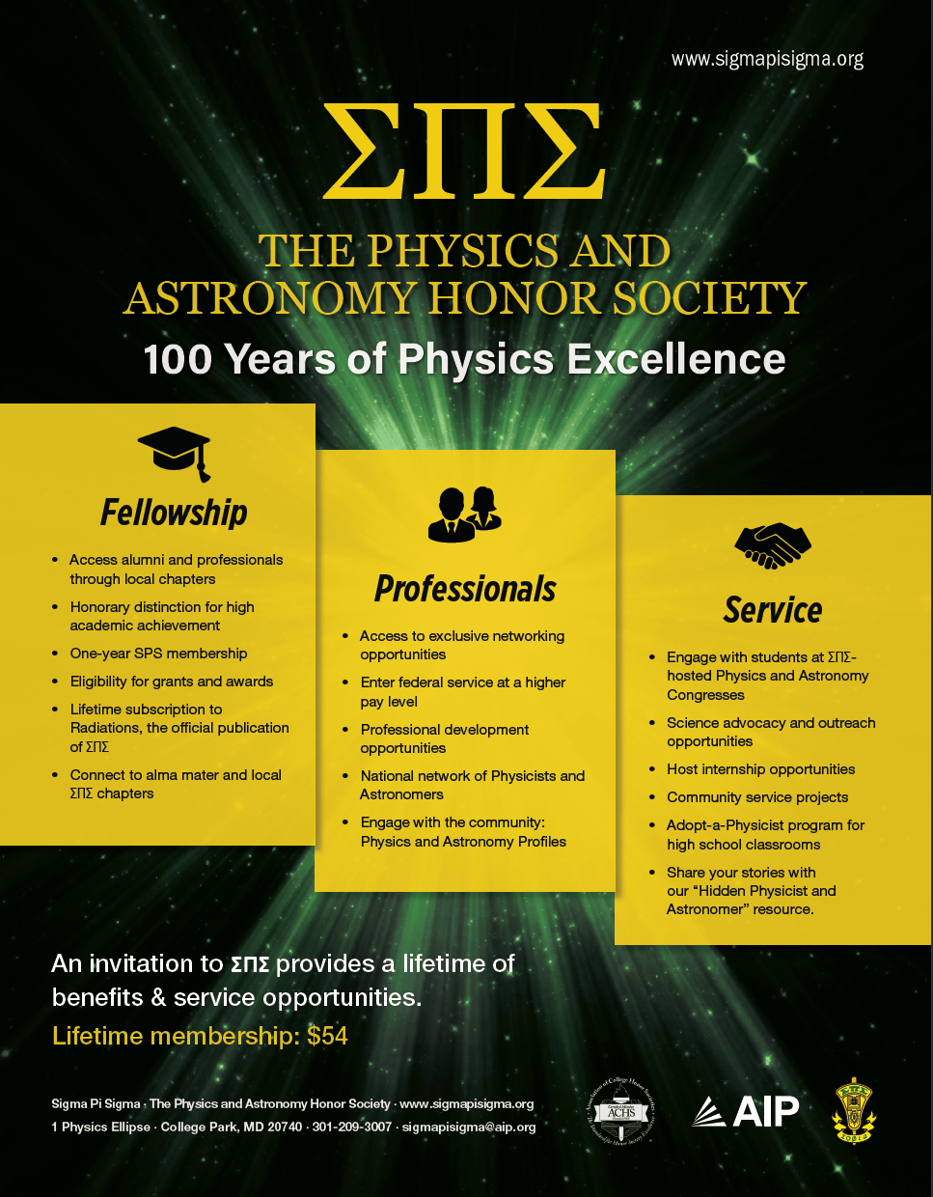
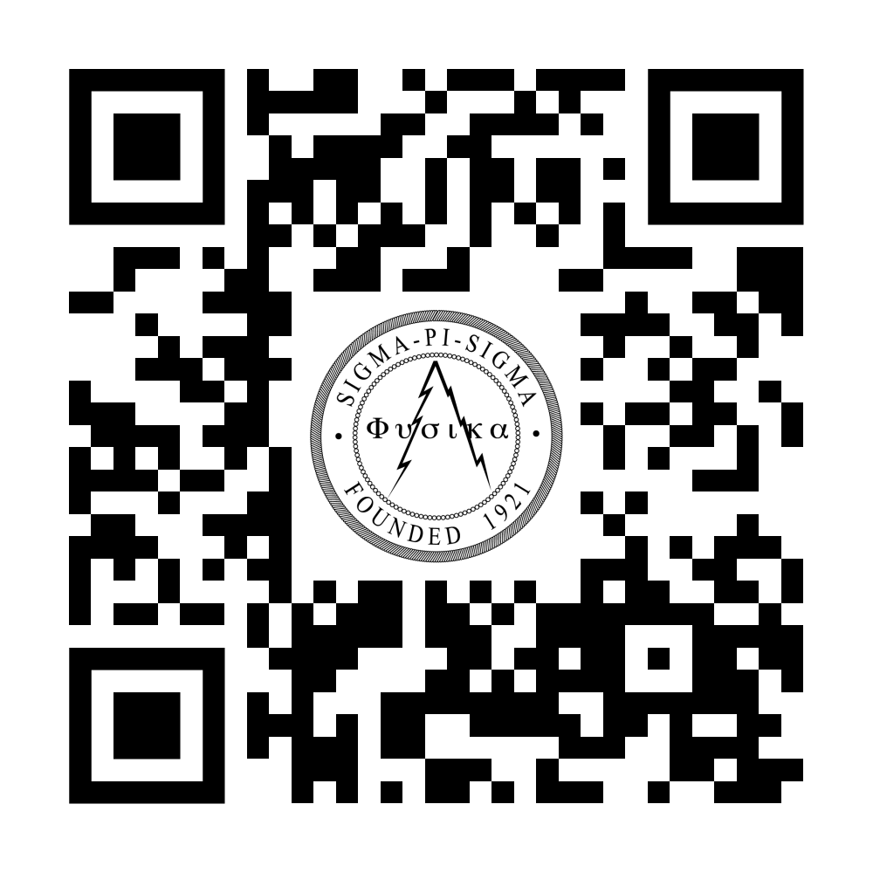
ΣΠΣ: Experiences, Opportunities, and Connections
ΣΠΣ encourages lifetime service
Attend future department induction ceremonies
Connect to current students:
Alumni Engagement Program
Support high school students: Adopt-a-Physicist
Connect to ΣΠΣ members through LinkedIn
Attend the 2028 ΣΠΣ Physics and Astronomy
Congress
Give talks to other chapters
Write for Radiations
Host student visits
Notes:
Sigma Pi Sigma is not just an induction ceremony, its a lifelong experience. You are encouraged to maintain a strong connection to your department. Through programs such as the Alumni Engagement Program, you will be able to connect you to chapters wherever you might go to act as mentors, tour guides, professional contacts, and department speakers. Sigma Pi Sigma can also help you impact the broader community through discussions with high school classrooms and participating in the Sigma Pi Sigma Physics Congresses. The pillars of Sigma Pi Sigma include service and fellowship and it is our hope that you can connect to individuals that can change not just your career but your life.
You are now a lifelong member of the Sigma Pi Sigma community.

Slide 19
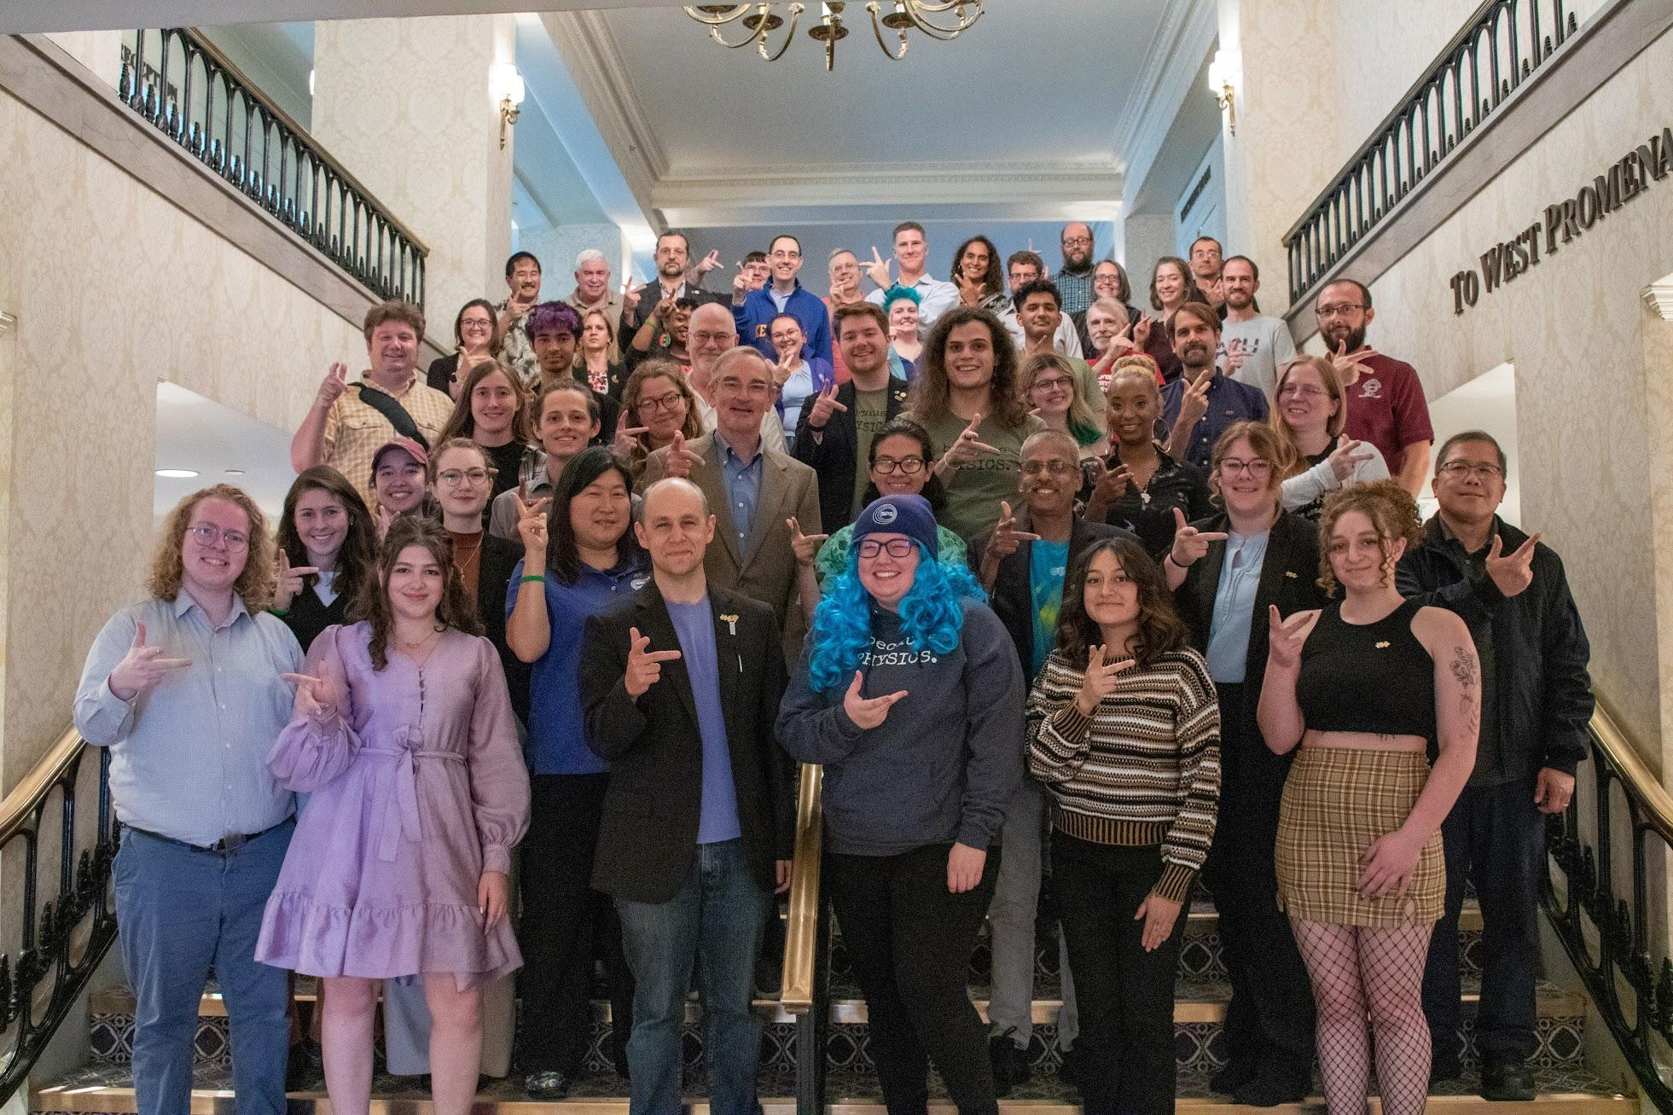
Congratulations!
Many thanks to the
family, friends, & professors, teachers, and mentors who helped our students arrive here.
SPS & ΣΠΣ Leadership:
Ron Kumon, SPS President 2025-2027
Blane Baker, ΣΠΣ President 2022-2026
Earl Blodgett, SPS & ΣΠΣ Interim Director
Kayla Stephens, Associate Director of SPS
Want to connect?
James Burrell, Member Services
sigmapisigma@aip.org
301-209-3007
www.sigmapisigma.org
Notes:
On behalf of the SPS and Sigma Pi Sigma National Offices, congratulations!
This accomplishment wouldn’t be possible without all those who helped the students. Let’s thank those that helped along the way.
I formally close this year’s induction ceremony and invite everyone to take photographs!

