Slide 1


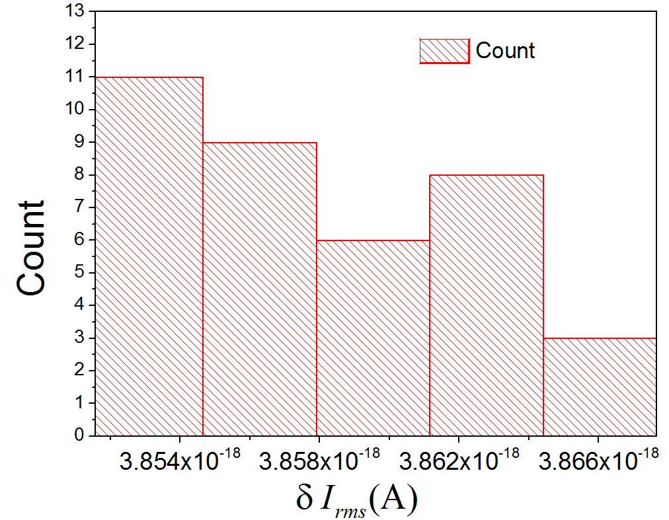
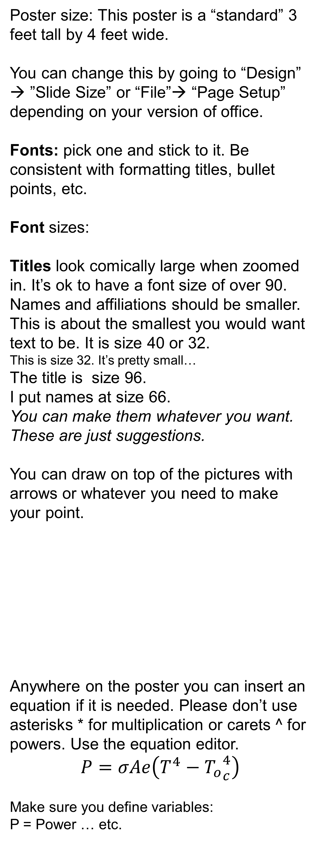
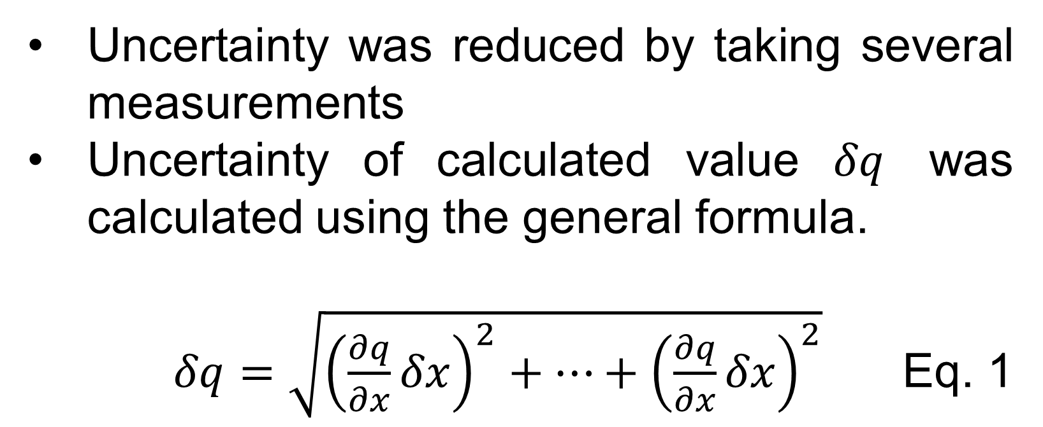
Title: A very generic poster
Brad R. Conradª and Robert Brown^{b}
ªDepartment of Silly Walks, Generic University, College Park, MD 20740
^{b}Department of Physics and Astronomy, College Name, San Francisco, CA 90210
Generic Title Block
Data
Results
Poster size: This poster is a “standard” 3 feet tall by 4 feet wide.
You can change this by going to “Design” → ”Slide Size” or “File”→ “Page Setup” depending on your version of office.
Fonts: pick one and stick to it. Be consistent with formatting titles, bullet points, etc.
Font sizes:
Titles look comically large when zoomed in. It’s ok to have a font size of over 90. Names and affiliations should be smaller.
This is about the smallest you would want text to be. It is size 40 or 32.
This is size 32. It’s pretty small…
The title is size 96.
I put names at size 66.
You can make them whatever you want. These are just suggestions.
You can draw on top of the pictures with arrows or whatever you need to make your point.
Anywhere on the poster you can insert an equation if it is needed. Please don’t use asterisks * for multiplication or carets ^ for powers. Use the equation editor.
$$P=σAe\left(T^{4}−{T_{o}}_{c}^{4}\right)$$
Make sure you define variables:
P = Power … etc.
Some general advice:
Don’t use sentences! People don’t read sentences. Try to use phrases and bullet points
Common Poster sections:
A short title - clearly state main topic
List authors with affiliations
Provide your contact information
Motivation or Introduction
Why should someone listen?
Theory/Method/Data
Analysis – Often separate from Data
Results
Conclusion
References
Acknowledgements/Logos – We got funds from SPS and our Department to attend
Measurement | Typical Value | Typical Uncertainty | Fractional Uncertainty
Voltage | 1.00V | 0.02V | 2 %
Resistance | 20000Ω | 200Ω | 1 %
Frequency Shift | 111000Hz | 4100Hz | 4 %
Temperature | 296.6K | 0.5K | 0.2 %
Results and Conclusion usually go on the right side of a poster. References will go at the bottom.
Notice that this column doesn’t have a block around it. Some people prefer this “cleaner” look.
Keep in mind that all conferences have different requirements, so make sure you check them out. For SPS, just make sure your poster size isn’t much bigger than this one is.
When you go to print, make sure you send a PDF because a PDF doesn’t change with what computer is looking at it.
Columns: You’ll notice I am writing in a column. Most posters are arranged into three equally sized columns.
Make the flow of the poster easy to follow:
Motivation → Background → Setup → Data → Analysis →
Results → Conclusions → References
This generic poster template can be helpful when you make your own poster. Remember to save as a PDF before you print!
Also, have others, such as a mentor, check over your poster before you print.
References
Put any references that you have down here. Make sure to cite your sources. Any images you use should be cited if you didn’t draw them. Here is an example:
M. P. Brown and K. Austin, The New Physique, Publisher City: Publisher Name, 2005, pp. 25-30.
Uncertainty was reduced by taking several measurements
Uncertainty of calculated value $δq$ was calculated using the general formula.
$δq=\sqrt{{\left(\frac{∂q}{∂x}δx\right)}^{2}+⋯+{\left(\frac{∂q}{∂x}δx\right)}^{2}}$ Eq. 1
A poster is really just a visual guide for to reference while you speak. You should never think “Oh, I wish I had a figure which showed _____” those figures should be on your poster. To make sure you have all the figures you need, you must practice your poster explanation several times before printing
Make illustrations in Powerpoint
Conclusions
Graphs should be large and easy to read. Text under a graph which explains the graph can be helpful but is not always necessary.
Figure 1: If you want to add Figure captions, they can be small. Keep them short and simple.

